Slide 1
ACE Team Playbook / Handover Process
- Azure CSS Chat Team

Slide 2
Agenda
Walkthrough
Support Topics
Support Plans
Handover Process
Coverage/Weekend Support
Changing Support Modality Chat/Phone/Email
Tips to encourage customers to share feedback
Other Processes

Slide 3
Support Topics/Support Plans
Support Topic Path | Support Topic Id | Chat Enabled
Availability and Connectivity | 32637216 | Yes
Availability and Connectivity/Azure Active Directory authentication | 32637235 | Yes
Availability and Connectivity/Cannot connect to my instance | 32739488 | Yes
Availability and Connectivity/Client drivers | 32637245 | Yes
Availability and Connectivity/Connection timeouts | 32637246 | Yes
Availability and Connectivity/Connection type (proxy or redirect) | 32637247 | Yes
Availability and Connectivity/Database in Recovering state | 32637254 | Yes
Support Plans
We cover all support plans except for ARR customers

Slide 4
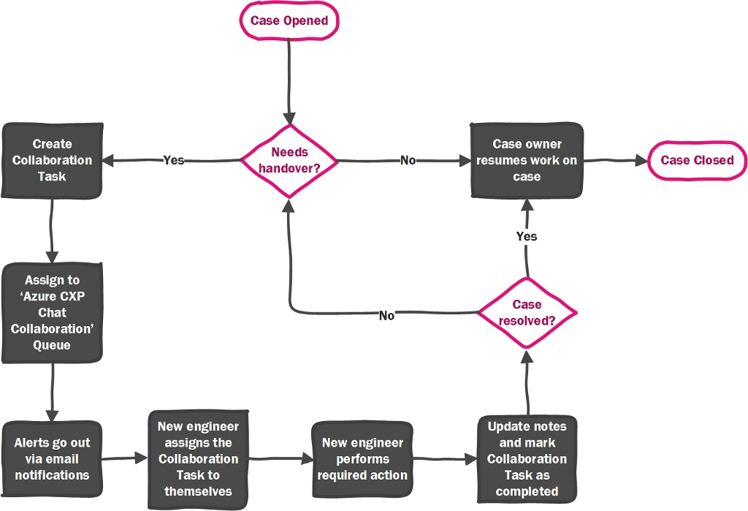
Handovers: To enable 24x5 support
Coverage 24X5
No Weekend Coverage
Detailed Handover Policy

Slide 5
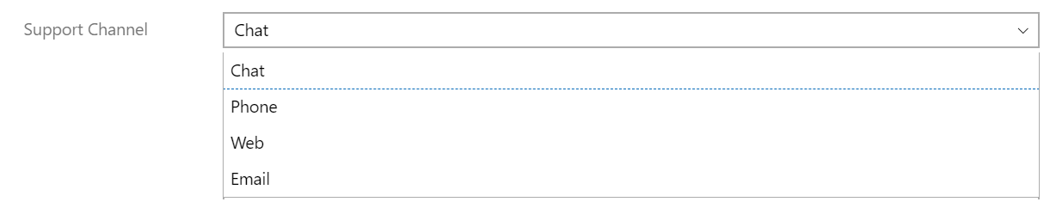
Changing support channel field
Stats based on Support Channel
To determine the number of chat cases resolved on Chat or Offline(Email/Phone), engineers are required to change the support channel in Service Request.
New Process
Update the support channel drop down value to Email/Phone in each service request unless the case is resolved on Chat and case is taken offline.
Wiki : Process to change Support Channel

Slide 6
Switching from Chat to Phone during live chat
PURPOSE: To ensure consistent customer experience and expectations across time zones for switching from Chat to Phone during a live session
SCENARIOS
Click here to read the guidelines
Request from customer early in the chat
Politely buy time, gather adequate information, and then honor the customer’s request.
Complex issues
If scoping / troubleshooting through chat is time-consuming then request a switch to phone.
Customer shows signs of frustration
Is customer getting restless / frustrated? Try phone, show empathy and try to make progress.
Communication / Language barrier
Concurrent chats
Politely inform that chat is English only at present. Offer transfer to get support in their language.
You may support in the customer’s language if you can. Add detailed case notes in English.
Anything not covered above?
If you are unable to switch right away, then politely inform the customer and honor the customer request when you can.
If the above guidelines do not address a scenario then write to Azure Chat Leads azchatleads@microsoft.com about the scenario with your suggestions for guidelines.

Slide 7
Tips to encourage customers to share feedback
We would like to increase CSAT responses for both chat and offline cases.
Two important points early on in the chat are to set realistic expectations as to what is possible in terms of getting the issue resolved on chat and also work to build rapport and empathize with the customer from the beginning of the chat.
Keep the customer updated throughout the chat and avoid long periods of no chat, ideally no more than 5-minute gaps. If you know it will take some time to check logs etc., let the customer know.
If you need to engage a SME/TA for assistance, be transparent with the customer that you are checking with a SME/TA and you will get back to them shortly on chat
If a chat is not going well, consider changing modality to phone and also screensharing if needed. Making the human connection on phone can help a lot.
Ask, Is there anything else you can do for the customer towards the end of chat.
Be quick asking for feedback on ending chat as customers often are in a hurry so build up to it..
For offline cases, always send a summary closing email and ensure you have permission from customer to close the case.
Full Guidelines on the wiki here.

Slide 8
Processes in Place
FQR and LQR
Weekly Low CSAT Triages
UVoc Items
Handle Quota Requests

Slide 9
ACE Playbook
Handover Process
ACE Team Playbook

